Slide 1
Consequences of rapid urbanisation
Key Stage 3
Comic Relief registered charity 326568 (England/Wales); SC039730 (Scotland).
Notes:
This presentation forms a part of a KS3 unit called Consequences of rapid urbanisation – exploring life in the settlements of Nairobi through the experiences of Dennis, a young boy living in Mukuru, Nairobi. The full set of resources can be downloaded from www.tes.co.uk/rednoseday
The presentation will help explore some of the core questions in your enquiry. The slides are designed to be used as a resource to dip into and divide over a series of lessons to support your enquiry structure, rather than shown in their entirety in one sitting.
For example:
Where are the slums? Slides 2–10
Why do slums develop? Slides 11–18
What are slums? Slides 20–26
Who lives in the slums? Slides 18-19
How and when will life improve in the slums? Slides 27–33
When is Red Nose Day 2013 and what can we do? Slides 32–33
For further guidance on how to structure the enquiry and use all the resources see page 4 of ‘Consequences of rapid urbanisation - Teachers’ notes’ available at www.tes.co.uk/rednoseday

Slide 2
Half the world live in cities
Fast growing. Every day the total number of people living in cities and towns goes up by 200,000.
Housing. The world would need to build an extra house per second to keep up.
Squatters. 1 in 6 people in the world are squatters.

Slide 3
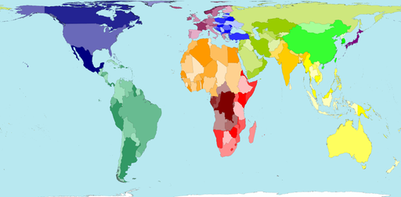
World: land area
UK
Kenya
www.worldmapper.org
Notes:
This map shows how much of the total proportion of land in the world is taken up by each country – in other words it is the map we are used to seeing to represent the world.
Tell your pupils:
You are going to see lots of these maps.
On these maps a country is coloured the same colour each time.
The colours are just to help you find a country. They do not mean anything else.

Slide 4
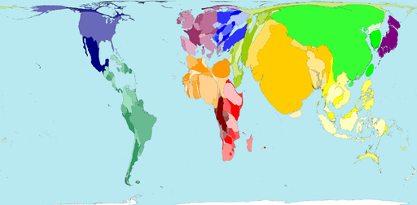

World: population
Land area
www.worldmapper.org
Notes:
The larger map now shows what proportion of the world’s total population live in each country. If no one lived in a place it would not be shown on the map at all. If all the people in the world lived in one country then that country would be shown as huge and no other countries would feature.
Suggested questions:
Why has the UK got bigger?
Which countries have a large land area but a small population? (Answer: e.g. Canada, Australia)
Which countries have a small land area but a large population? (Answer: e.g. Bangladesh, UK and Japan)
Which continent is most distorted in terms of having high population compared to land area? (Answer: Europe or Asia)

Slide 5
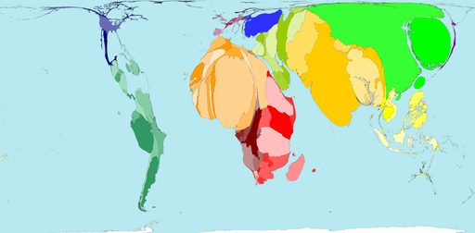

World: slum growth
Population
www.worldmapper.org
Notes:
The larger map now shows recent growth in slum dwellers across the world. In the 10 years from 1991 to 2001 over 200 million people became slum dwellers. This map shows where those new slum dwellers live. If all 200 million slum dwellers lived in one country then this would be the only country on this map.
Suggested questions:
Name one country with high level of slum growth.
Name one country with low level of slum growth.
What map would you like to see next and why?

Slide 6
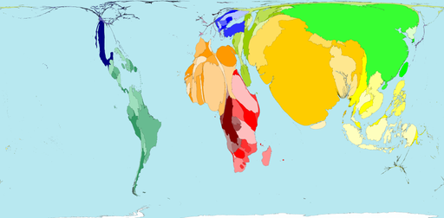

World: poverty*
* Living on less than the equivalent of $10 per day
Slum growth
www.worldmapper.org
Notes:
The larger map now shows where the poorest people in the world live. The size of the countries is increased according to the number of people living on the equivalent of less than 10 US dollars per day. The important thing for pupils to understand is that equivalent here means purchasing power parity (PPP) i.e. the people in this category earn less than what 10 US dollars a day will buy you in the USA. So, if 10 US dollars buys 2 loaves of bread, 2kg of vegetables and some petrol in the USA , the equivalent is worked work out for what the same things would cost in another country.
Suggested question:
Why are the two maps above so similar in shape? Give reasons.
For more details about cost of food, travel and rent in Kenya see www.numbeo.com/cost-of-living/country_result.jsp?country=Kenya

Slide 7
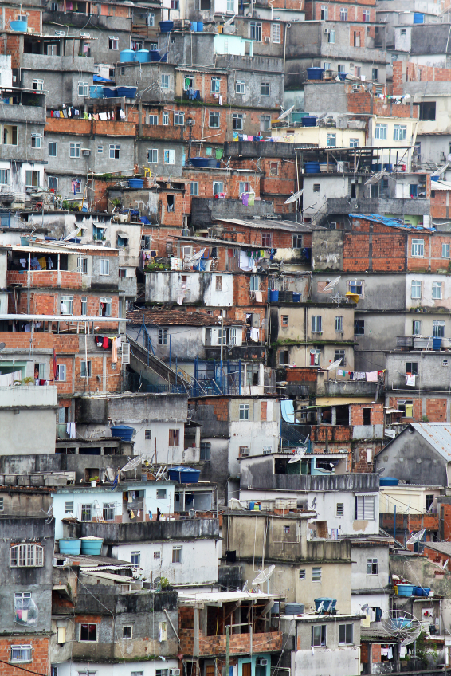
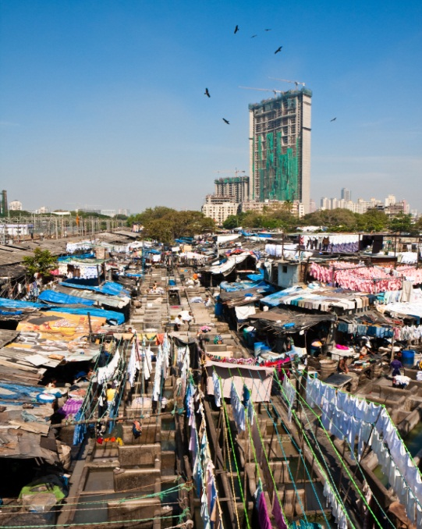
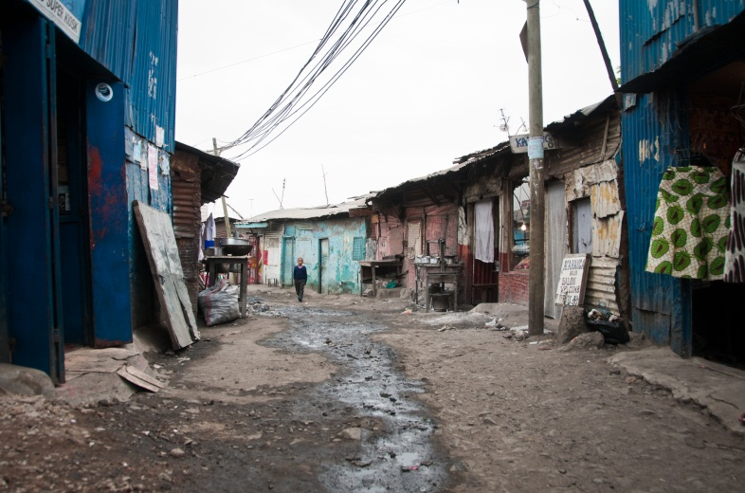
Worldwide phenomenon
Rio
Mumbai
Nairobi
Notes:
These pictures are of slum settlements in Rio, Mumbai and Nairobi.
(Photo credits: Rio: Istock photo purchased, no attribution required; Mumbai: Istock photo purchased, no attribution required; Nairobi: Jonathan Kalan)

Slide 8
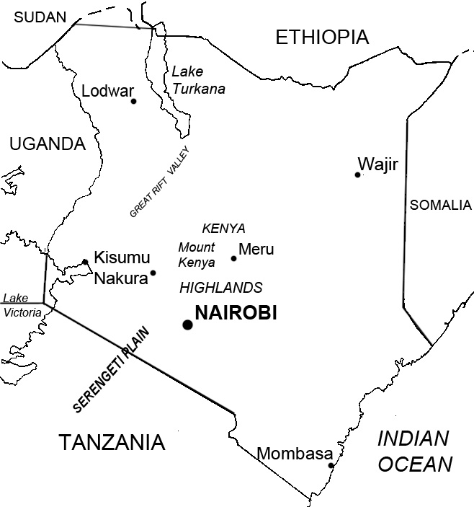
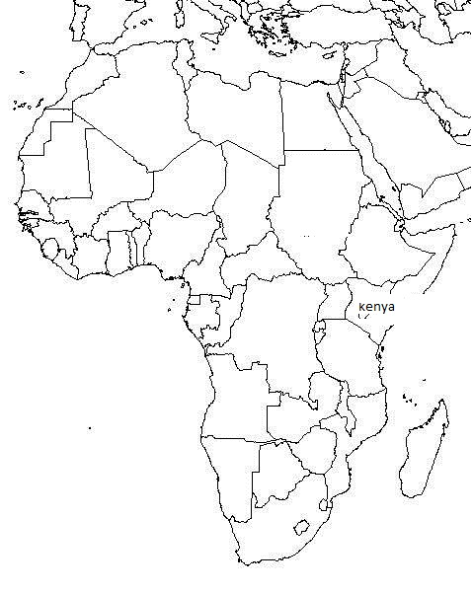
Kenya
Notes:
Map of Kenya
The western part of the city is the highest and has the Ngong Hills. The eastern side is lower and flat. There are three rivers running through Nairobi – the river Ngong, river Nairobi and river Mathare. They can be seen in many of the slum districts. There are forests in Northern Nairobi and a national park nature reserve in the south west. Mount Kenya rises further away in the north and Mount Kilimanjaro is across the border with Tanzania to the south east. Minor earthquakes and tremors occasionally shake the city, as Nairobi sits next to the Rift Valley, which is still being created as tectonic plates move apart.
These maps are available as a downloadable pupil sheet ‘Outline maps (Kenya and Africa)’ at www.tes.co.uk/rednoseday

Slide 9
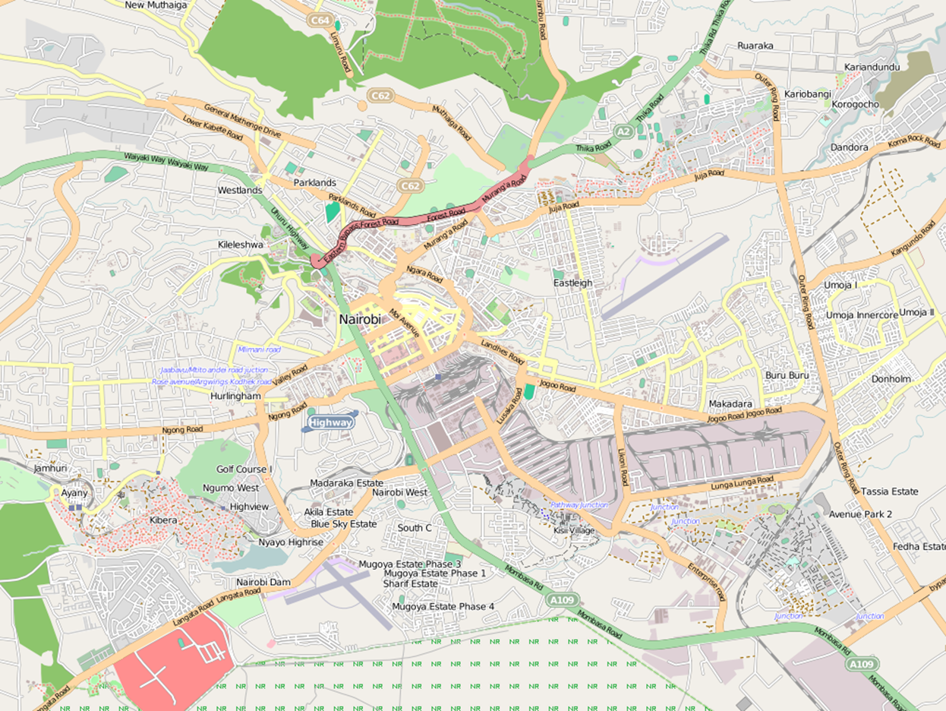
Introducing Nairobi
www.openstreetmap.org
Notes:
Open Street Maps is an excellent mapping resource (www.openstreetmap.org)
Also see the Mapping Kibera project (www.mapkiberaproject.org). A team of volunteers are collecting reliable data and producing maps showing the physical and socio-demographic features of the Kibera slum. These are available through a digital geo-referenced database. On the basis of their mapping to date, they claim that estimates of Kibera’s population are greatly exaggerated and it is more likely to be 270,000 rather than the 800,000 often claimed.

Slide 10
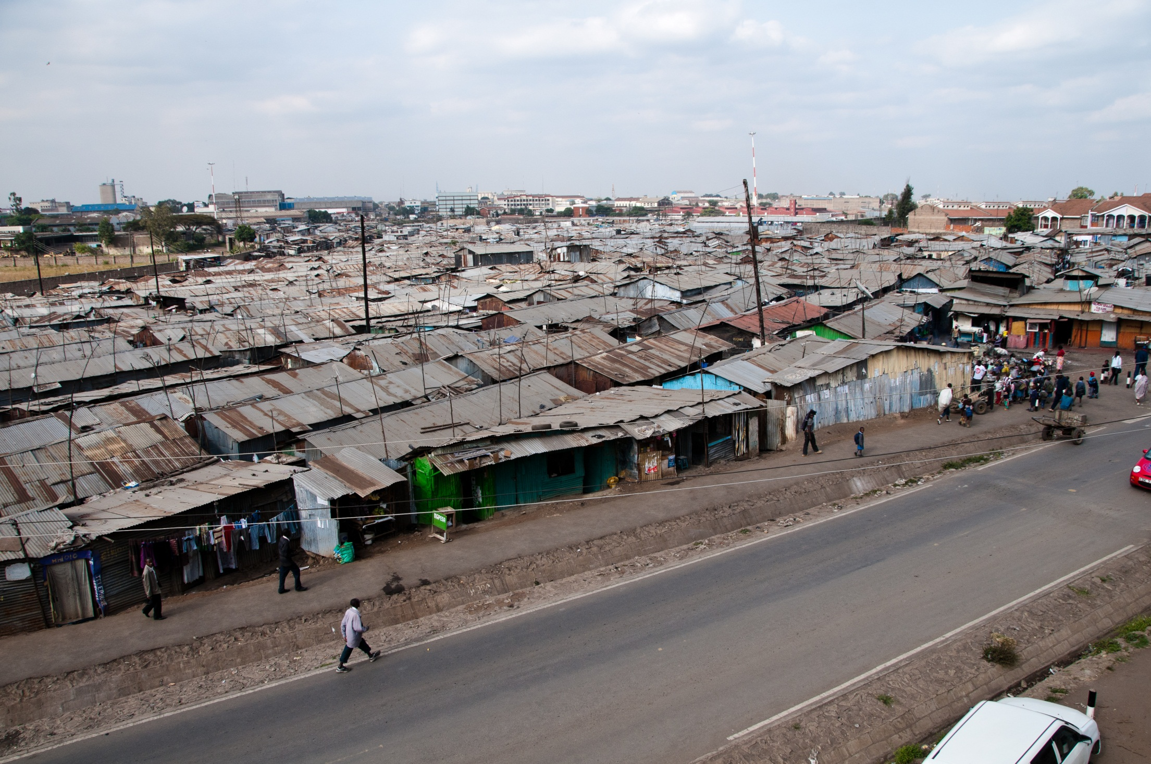
Nairobi
Notes:
Nairobi originated as the headquarters of the Kenya Uganda Railway, which was established when the railhead reached Nairobi in June 1899. The city grew into British East Africa’s commercial and business hub and by 1907 became the capital of Kenya.
Population:
1948 = 120,000
1999 = 3 million
2010 = 3.2 million
(Photo credit: Jonathan Kalan)

Slide 11
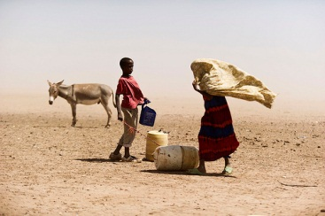
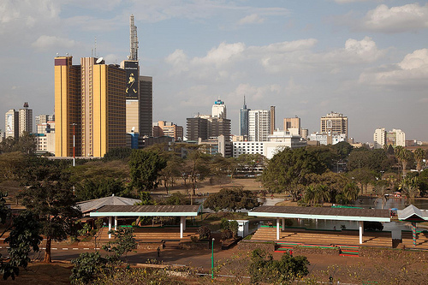
Why do people migrate?
Wajir
Nairobi
Push
Pull
Notes:
Push factors – aspects of your life that are negative and encourage you or force you to move away. Examples include:
food shortages due to recent poor harvests
deserts expanding so less land available for crop growing
unreliable rains due to climate change so poorer grassland for livestock
lack of employment opportunities
poor health including high rates of disease
low life expectancy
high child and maternal mortality
lack of education opportunities after age 14
people may think that life here will always be the same or could even get worse
Pull factors – things in the target place that encourage people to move there. Examples include:
availability of greater range of employment, higher rates of pay, larger companies who could offer promotion in the future
universities and secondary school for children’s education
better hospital and clinic facilities for safer childbirth, child health and, in case of accidents, better links with the rest of the world
access to new technology
more modern, more exciting, people may think that life here will be better in the future and offer better opportunities for their family and especially for their children’s future
(Photo credits: US_AID on flickr and ollipitkanen on flickr)

Slide 12
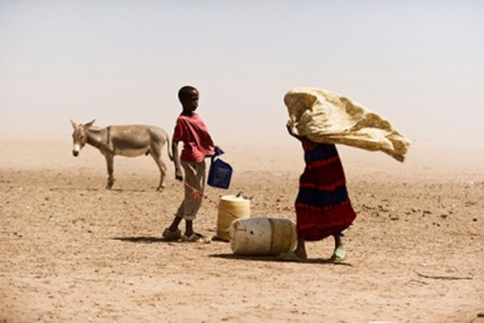

Push factors
Notes:
Quick-fire brainstorm on push factors
Push factors include:
food shortages due to recent poor harvests
deserts expanding so less land available for crop growing
unreliable rains due to climate change so poorer grassland for livestock
lack of employment opportunities; poor health including high rates of disease
low life expectancy, high child and maternal mortality; lack of education opportunities after age 14
the belief shared by many that life here will always be the same or could even get worse
(Photo credit: US_AID on flickr)

Slide 13
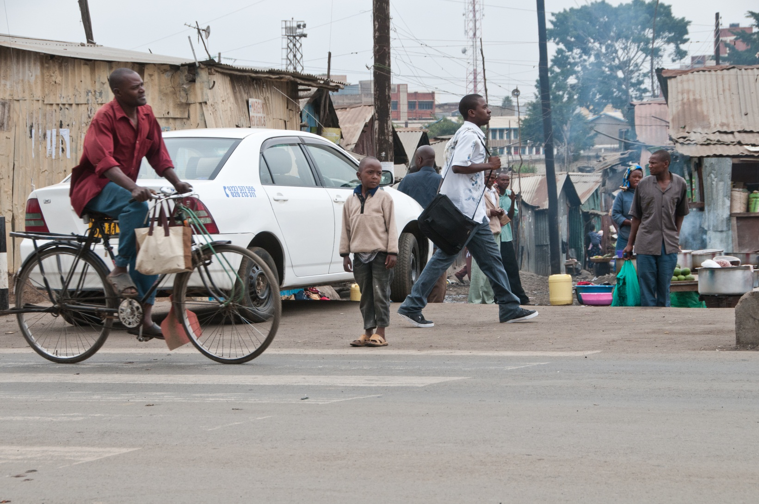
Pull factors
Notes:
Quick-fire brainstorm on pull factors
Pull factors include:
availability of greater range of employment, higher rates of pay, larger companies who could offer promotion in the future
education opportunities for young people, including universities and secondary school
better hospital and clinic facilities for safer childbirth, child health and, in case of accidents, better links with the rest of the world
access to new technology
attraction of a more modern, more exciting life
the belief that life in the city offers a better future, especially for their children, and greater opportunities for families
(Photo credit: Jonathan Kalan)

Slide 14
Rural to urban – reasons for moving
Negative
Positive
 | Wajir | Nairobi
Notes:
Pupils should complete the blue and yellow boxes.
The blue area represents the push factors – the reasons for deciding to leave Wajir temporarily or permanently.
Negative factors could include: desertification, crop failure, famine, poor harvests, cash crop prices down, land no longer farmable due to unreliable rainfall, climate change, natural disasters, lack of education facilities for 11+ children, poor health and high incidence of disease (e.g. malaria), land tenure issues, racial or tribal persecution, things getting worse, lack of opportunity for children.
The yellow area represents the pull factors – the reasons for choosing to migrate to Nairobi.
Positive factors could include: range of employment opportunities, higher wages, long-term prosperity, better education facilities for 11+ children, health and hospital facilities, childbirth facilities, to join existing family.
As an additional activity, pupils could add factors to the white squares and consider the implications for both places.
The top-right box is key to understanding issues in a slum settlement.

Slide 15
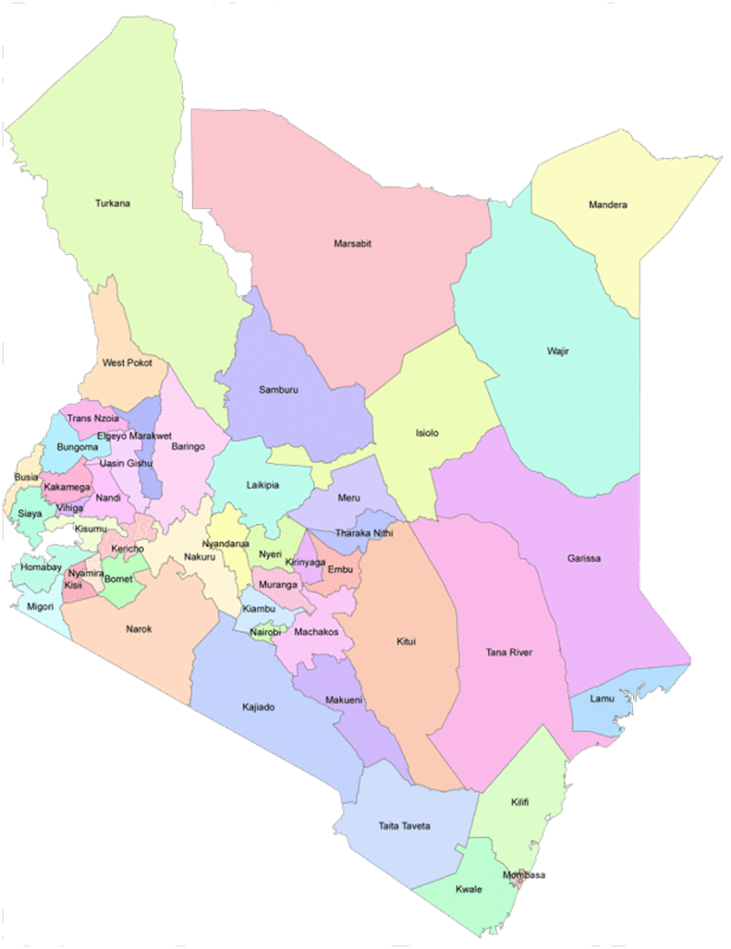

Wajir county
Wajir is a county in NE Kenya. It has borders with Somalia and Ethiopia. It is mainly a rural area but has one large city called Wajir. The county of Wajir is huge – covering an area half the size of England.
Notes:
(Photo credit: US_AID on flickr)

Slide 16
Comparative data: Wajir, Nairobi
Notes:
This table is available as a pupil sheet ‘Comparative data for the counties of Wajir and Nairobi’ at www.tes.co.uk/rednoseday

Slide 17
Rapid urbanisation causes and effects
Notes:
You could do a quick-fire brainstorm with your pupils to generate a list of cause and effects.

Slide 18
Population data
Wajir county 2010
 | Female ‘000 | Female as % of total |  | Male ‘000 | Male as % of total
0-10 | 102 | 15 |  | 114 | 17.2
11-20 | 86 | 13 |  | 125 | 18.9
21-30 | 40 | 6 |  | 44 | 6.7
31-40 | 34 | 5.2 |  | 27 | 4
41-50 | 19 | 2.8 |  | 24 | 3.6
51-60 | 8 | 1.2 |  | 14 | 2.1
61-70 | 4 | 0.6 |  | 8 | 1.2
71-80 | 3 | 0.4 |  | 4 | 0.6
81+ | 2 | 0.3 |  | 2 | 0.3
Total | 298 | 44.5 |  | 362 | 54.4
Nairobi county 2010
 | Female ‘000 | Female as % of total |  | Male ‘000 | Male as % of total
0-10 | 353 | 11.2 |  | 351 | 11.1
11-20 | 281 | 8.9 |  | 236 | 7.5
21-30 | 494 | 15.7 |  | 446 | 14.2
31-40 | 237 | 7.5 |  | 317 | 10.1
41-50 | 99 | 3.1 |  | 155 | 4.9
51-60 | 40 | 1.2 |  | 66 | 2.1
61-70 | 16 | 0.5 |  | 22 | 0.7
71-80 | 7 | 0.2 |  | 7 | 0.2
81+ | 5 | 0.1 |  | 3 | 0.1
total | 1532 | 48.4 |  | 1603 | 50.9
Notes:
This table is available as a pupil sheet ‘Population data for constructing population pyramids ’ at www.tes.co.uk/rednoseday

Slide 19

Dennis
Notes:
Introduce Dennis to your pupils with the video ‘Welcome to my world’ available at www.tes.co.uk/rednoseday
(Photo credit: Jonathan Kalan)

Slide 20
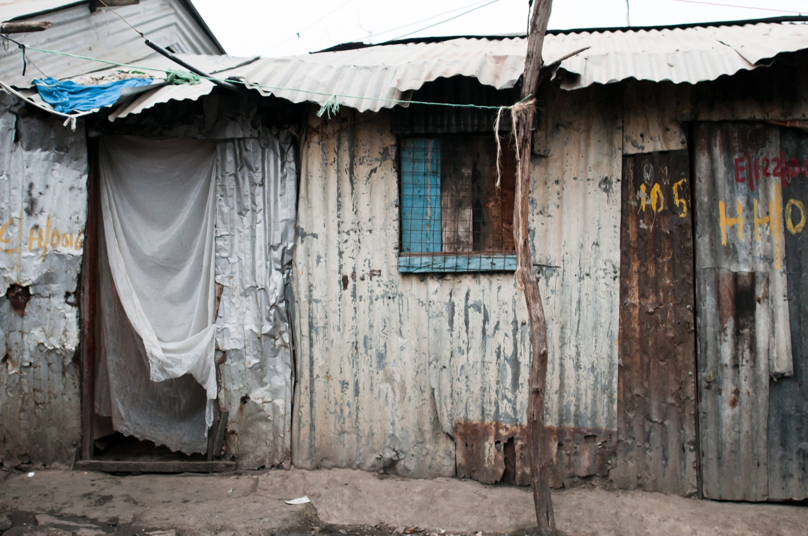
Inadequate construction
Notes:
The following few slides look at some physical problems with slum settlements. In ‘Consequences of rapid urbanisation – Teachers’ notes’ (available at www.tes.co.uk/rednoseday) you’ll find a UN definition of a slum and further information on the five factors that characterise urban slums.
You could also use the following pupil sheets available at www.tes.co.uk/rednoseday.
‘Line drawings to annotate (house and street)’
‘Characteristics of urban slums’
(Photo credit: Jonathan Kalan)

Slide 21

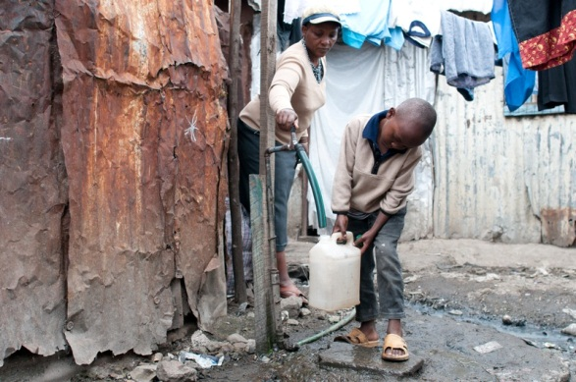
Water supply
Notes:
(Photo credit: Jonathan Kalan)

Slide 22
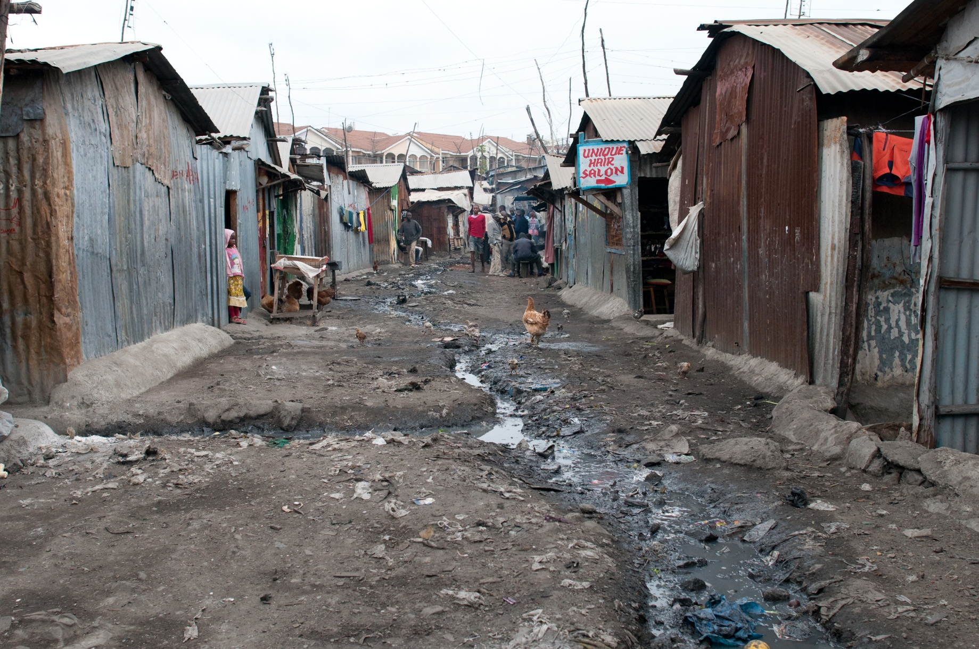
Sanitation
Notes:
(Photo credit: Jonathan Kalan)

Slide 23
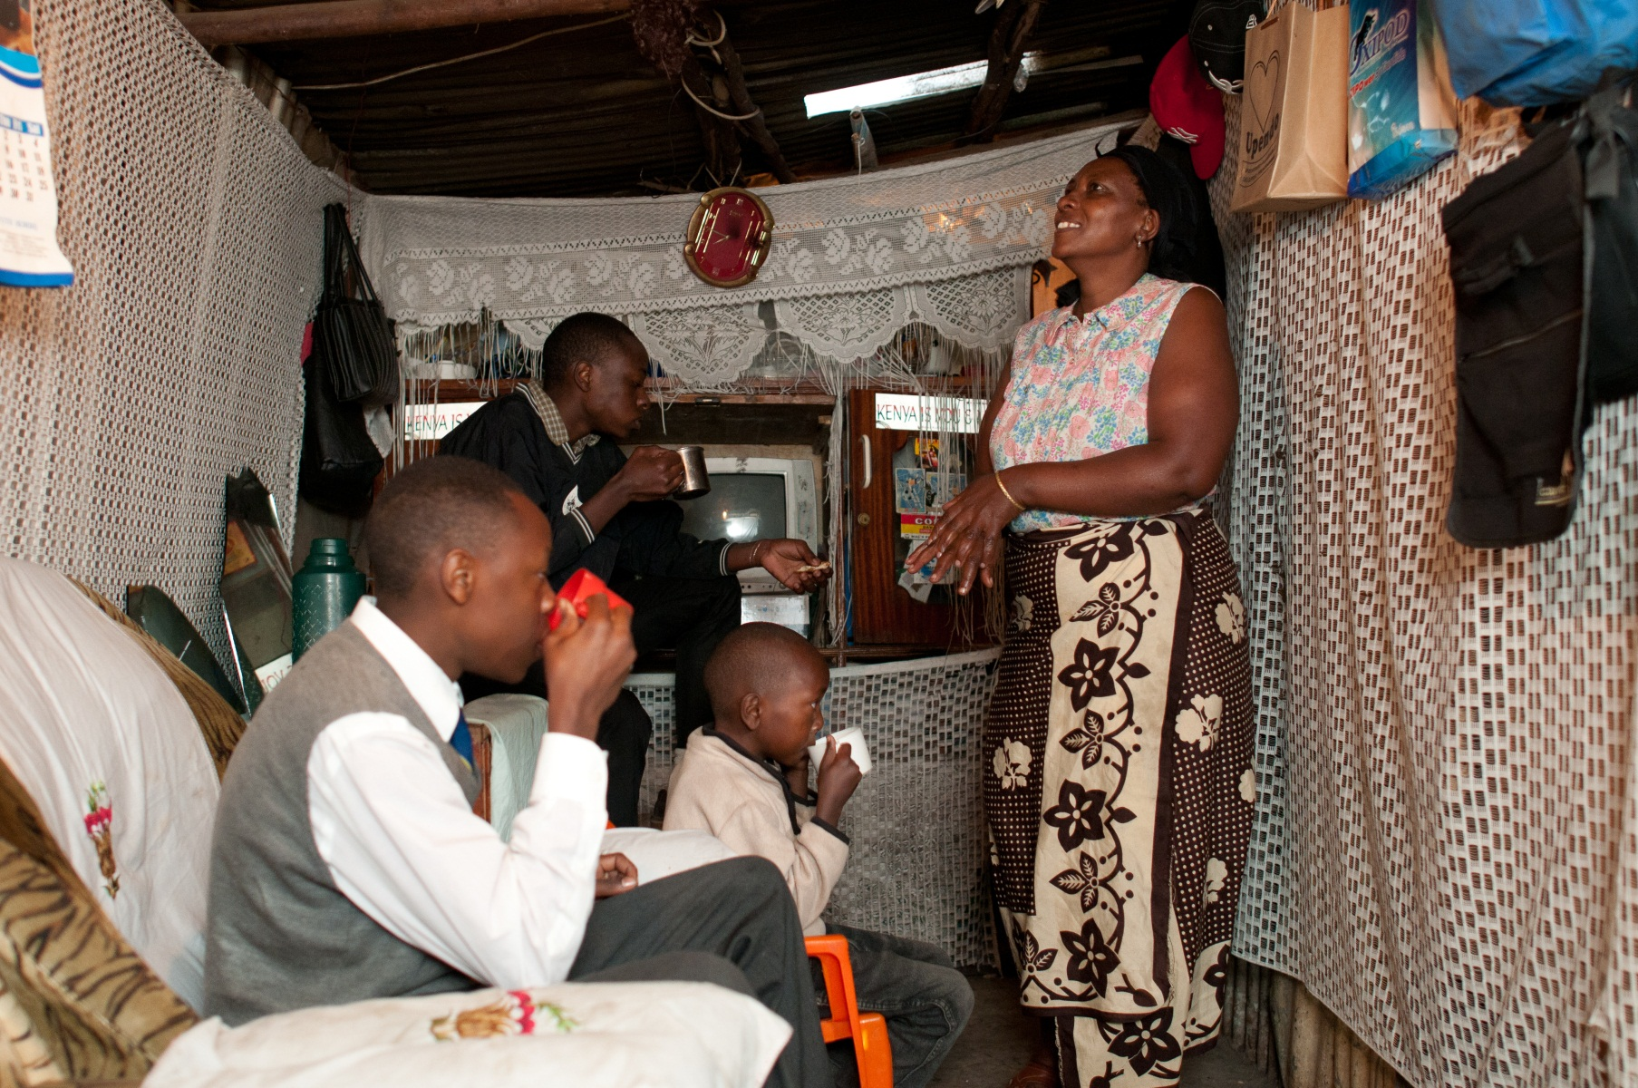
Overcrowding
Notes:
(Photo credit: Jonathan Kalan)

Slide 24
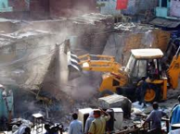
Insecure land and property tenure
Notes:
Tenure: The majority of slum residents in Nairobi are tenants (about 80%). They pay rent to landlords or structure owners (20%) who in turn do not own the land on which the houses and structures stand. As landlords rarely own the land, there is no security of tenure for either structure owners or tenants. The majority of land used for informal settlements is public government land, including land reserved for roads, electricity lines and railway tracks, or land on dumping grounds and river banks. Some of this land was given away to private individuals during the 1960s despite the fact that people had settled on it.
Slum householders are subject to:
arbitrary rent increases
unreasonable restrictions on the use of the homes
evictions carried out with use of excessive force and with no notice or consultation
Lack of secure tenure is a factor in the council’s and communities’ reluctance to improve housing and related infrastructure.
(Photo credit: slumdwellersinternational on flickr)

Slide 25
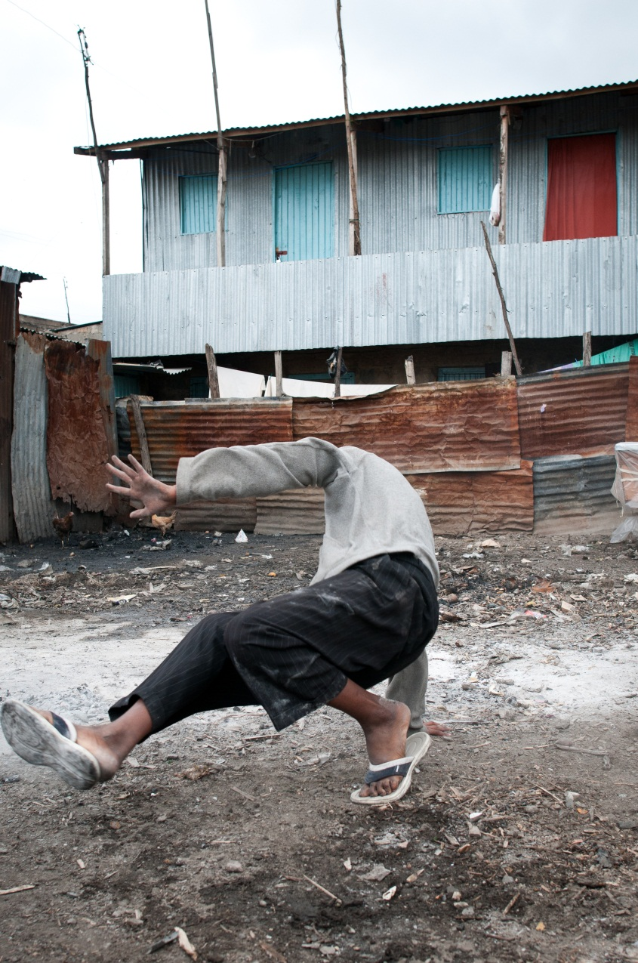
Risky places
What are the risks?
Physical and environmental
Economic
Social
Political
Notes:
Thinking of risk as: likelihood of negative outcome x severity of effect if it occurs x frequency of it occurring
(Photo credit: Jonathan Kalan)

Slide 26
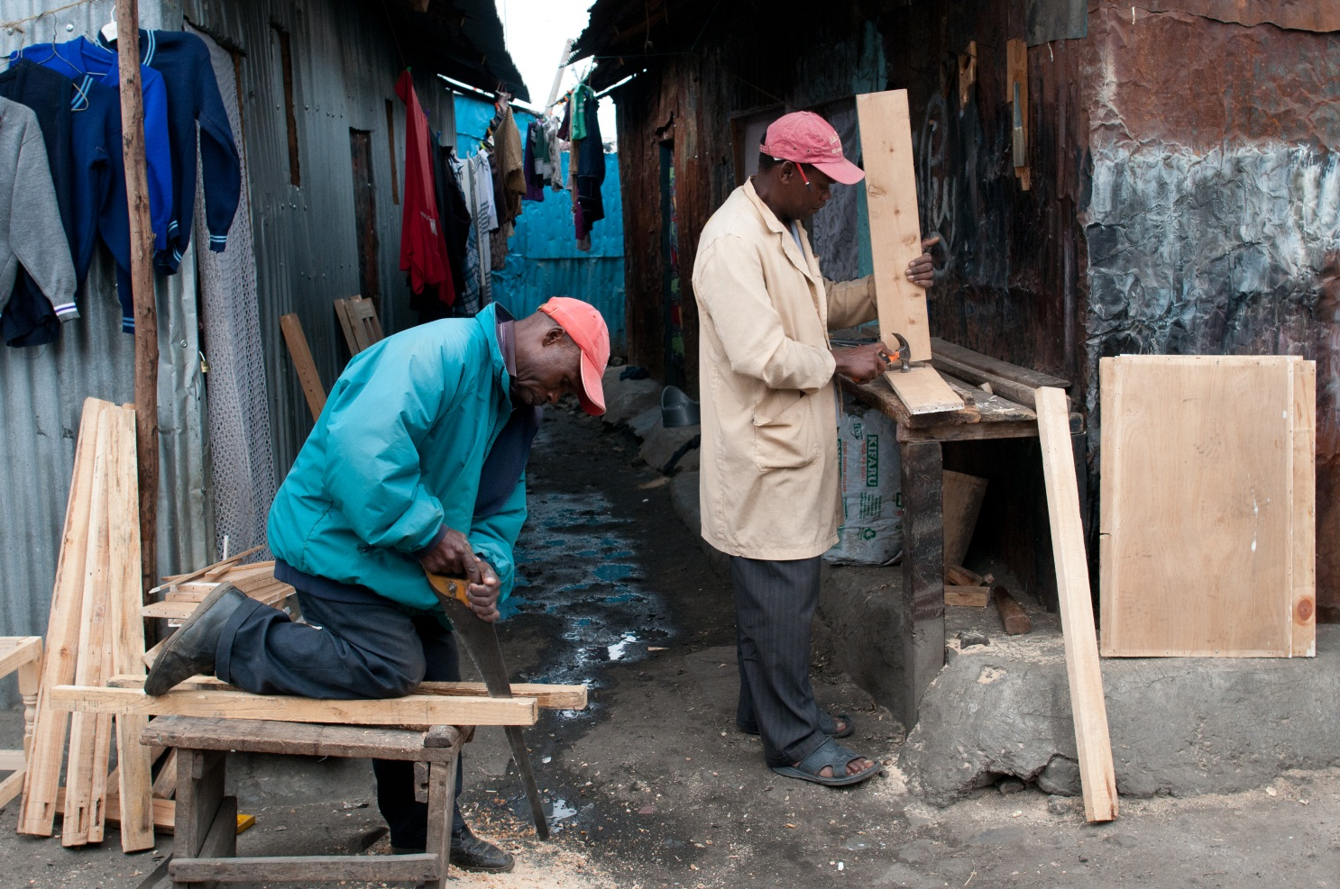
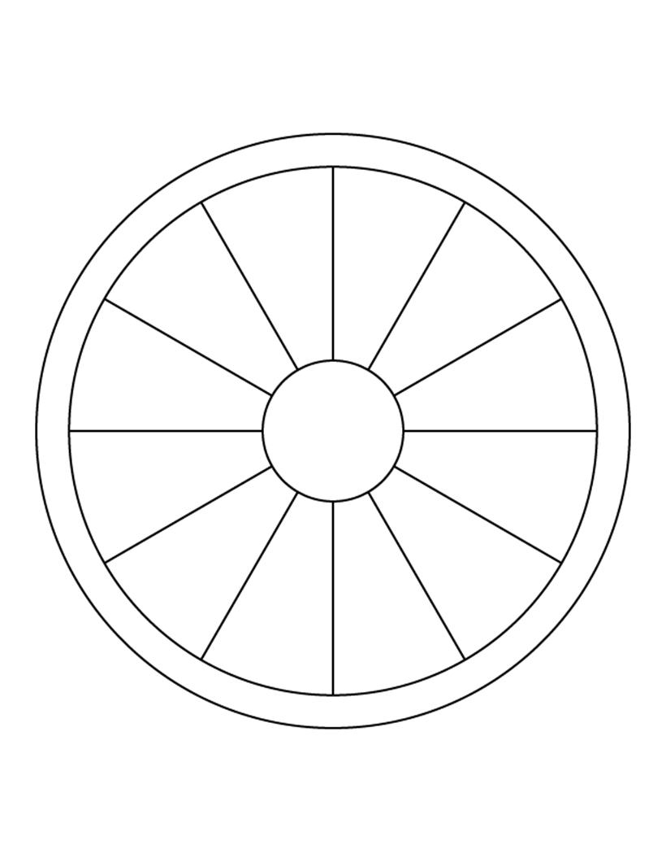
Places of opportunity
The informal economy in Kenya is known as System D and Jua Kali.
What are the advantages of Jua Kali over the formal economy?
Notes:
You can download the pupil sheet ‘Worksheet: Jua Kali’ at www.tes.co.uk/rednoseday
See the ‘Consequences of rapid urbanisation – Teachers’ notes’ for further information on the informal sector, Jua Kali, M-pesa and System D.
For examples of the Jua Kali sector at work, watch the following clip www.youtube.com/watch?v=No11VCrj4wM
For case studies of Jau Kali, look at ‘Making do – Innovation in Kenya’s Informal Economy’ (a PDF pamphlet by Steve Daniels) www.analoguedigital.com/docs/makingdo-download-lores.pdf
(Photo credit: Jonathan Kalan)

Slide 27
Millennium Development Goals
Improving living conditions in the slums is part of the Millennium Development Goals (MDGs).
MDG Goal 7, Target 11 The United Nations system assigned UN-HABITAT the responsibility of assisting Member States to monitor and gradually attain the “Cities Without Slums” target, also known as Target 11.
“By 2020, to have achieved a significant improvement in the lives of at least 100 million slum dwellers”.
Notes:
MDGs and role of UN
The Millennium Declaration was adopted by Member States of the United Nations in September 2000. It contains 8 Millennium Development Goals (MDGs), ranging from eradicating extreme poverty to combating HIV/AIDS and educating children. Each of the MDGs is made up of specific development targets, each of which has a target figure, a time frame, and indicators designed to monitor the extent to which the target has been achieved.
Housing conditions in the slums are listed in MDGs as part of goal number 7 ‘Ensure Environmental sustainability’. The specific target concerning slums is number 11 – “By 2020, to have achieved a significant improvement in the lives of at least 100 million slum dwellers”.
The UN branch which co-ordinates this is UN-HABITAT and their HQ happens to be based in Nairobi. For a current picture of global progress to 2012 see http://www.un.org/millenniumgoals/pdf/MDG%20Report%202012.pdf
Or in summary:
‘Improvements in the lives of 200 million slum dwellers exceeded the slum target. The share of urban residents in the developing world living in slums declined from 39 per cent in 2000 to 33 per cent in 2012. More than 200 million gained access to either improved water sources, improved sanitation facilities, or durable or less crowded housing. This achievement exceeds the target of significantly improving the lives of at least 100 million slum dwellers, well ahead of the 2020 deadline’.

Slide 28
Big problem, big solution?
Slum clearance schemes
Notes:
Slum clearance due to new housing estates: Following independence in 1963, the new government of Kenya realised that housing was in short supply. They made an ambitious commitment to ensure that every family in Nairobi lived in acceptable urban housing. They planned to build large-scale public housing estates with subsidised rents and began to demolish any housing structure which did not meet their minimum standard. The displaced residents moved to marginal areas of Nairobi where they built new slum settlements. The housing programme was further limited in effect by rapid natural population growth and high rates of rural to urban migration, which meant that the government provided only a fraction of the housing units needed and new settlements developed as fast as they were cleared.
Slum clearance due to ownership disputes: Although the government and city council owned large amounts of land, much of this had been promised to various groups as places to live, e.g. the settlement of Kibera had been occupied since Nairobi began as a city. In the 1980s it was common for land to be used as a bribe, reward, or to purchase political favours. Land given away in this way included land already occupied by informal settlements. The new ‘owner’ would generally want to evict the informal settlements and large-scale evictions and demolitions took place as a result of this practice.
(Photo credit: slumdwellersinternational on flickr)

Slide 29
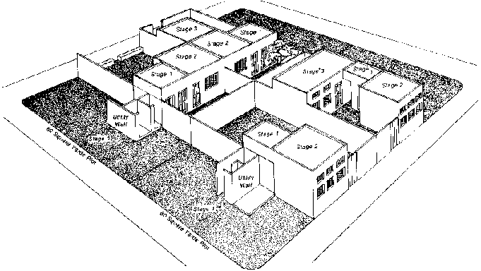
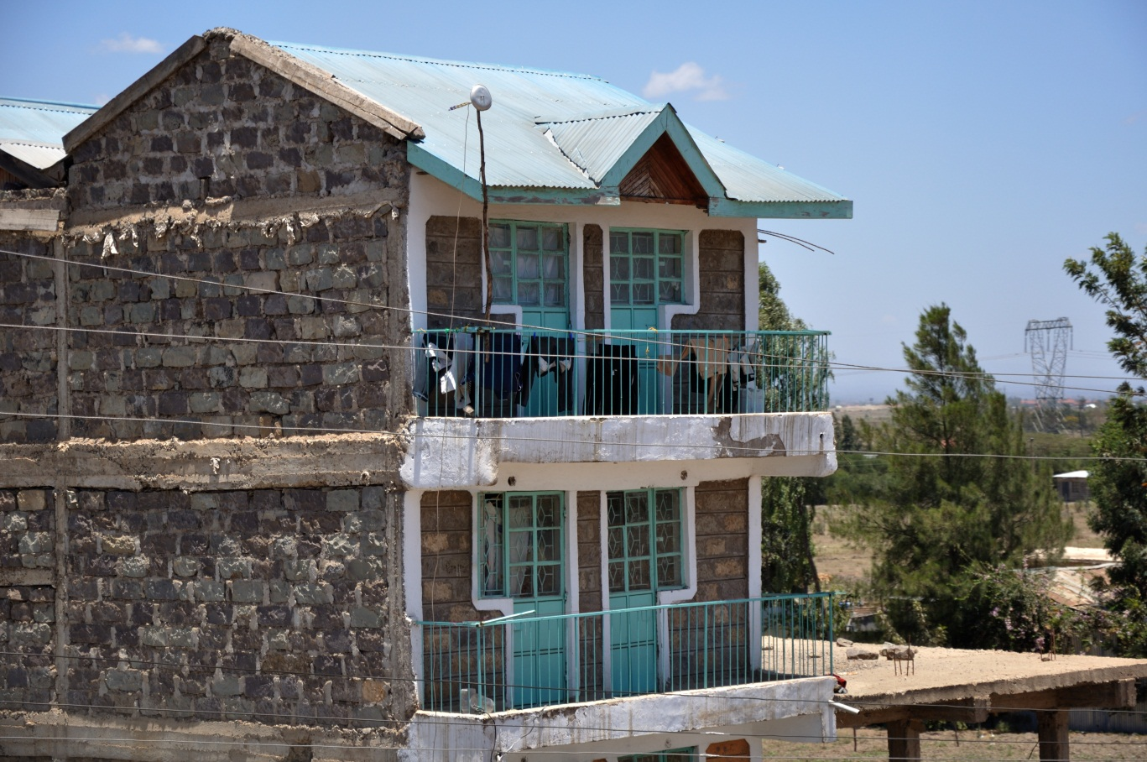
Big problem, expensive solution?
Site and services schemes
Notes:
The site and services schemes of the 70s and 80s, for example in a suburb of Nairobi called Dandora, were early slum upgrading projects sponsored by USAID and World Bank. Though hailed as a success at the time, it is now clear that these projects did not meet cost-recovery standards and left a legacy of debt to national governments. The schemes were discredited when people sold on property for large profits without provision for affordable maintenance of sewerage and water systems. Studies started to reveal that sites and services schemes were not reaching the target populations and that many housing units meant for low-income beneficiaries were being bought out by individuals with higher incomes.
(Photo credit: wikimedia commons)

Slide 30
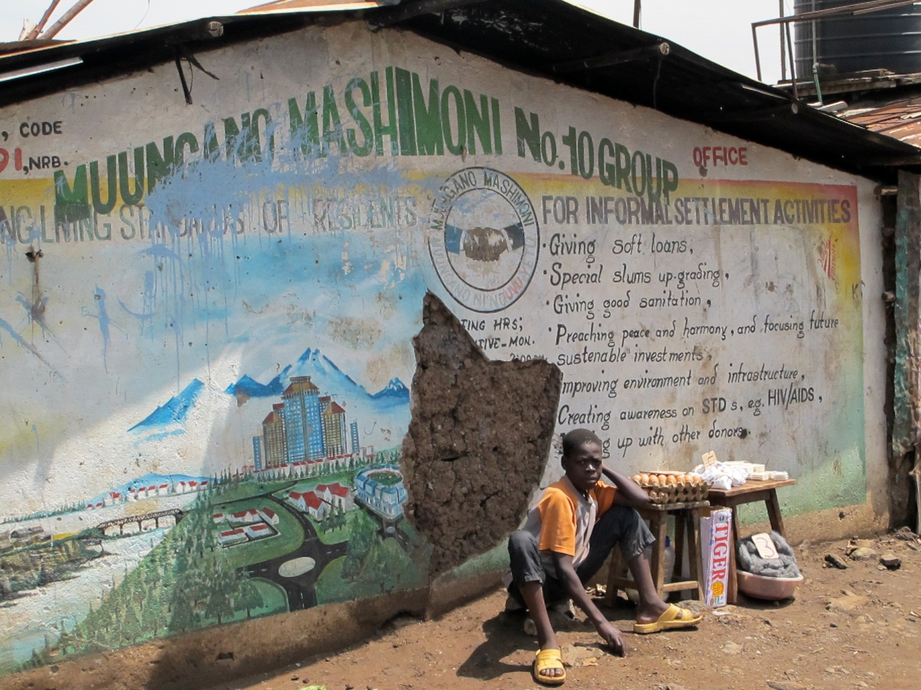
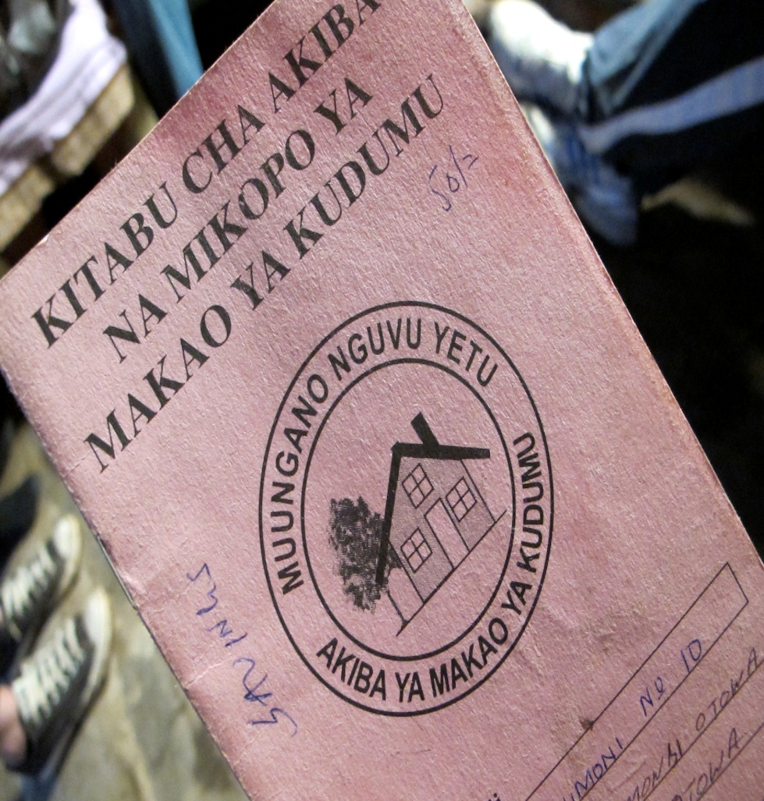
Big problem, lots of small solutions?
Enumeration Savings schemes
Notes:
The Pamoja Trust
Pamoja is a partner organisation to Muungano wa Wanavijiji, founded in 2000. The focus of the trust is to provide a voice for slum dwellers and help with negotiations between landlords, city councils, developers, etc. in order to improve conditions in the slums and reduce evictions.
The focus of Pamoja’s work is community-led upgrading of informal settlements. It generates social capital by community empowerment, mobilising communities, creating change and collective action. Pamoja emphasise that the two tools to make change happen are the process of enumeration and the setting up of savings schemes.
See ‘Consequences of rapid urbanisation – Teachers’ notes’, available at www.tes.co.uk/rednoseday for more detail on savings schemes.
(Photo credits: slumdwellersinternational on flickr)

Slide 31
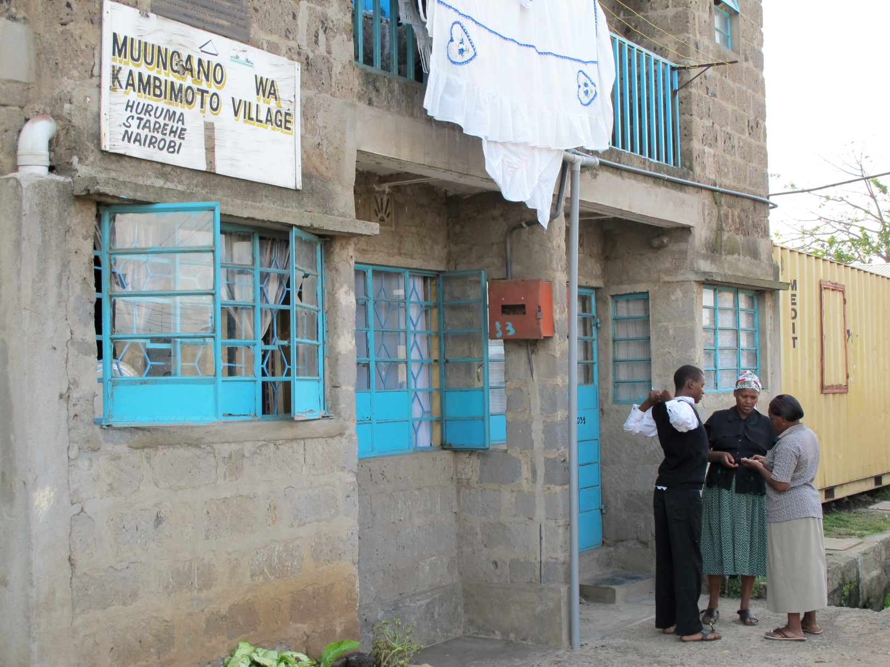
Community housing
Notes:
Case study of successful intervention by Pamoja Trust – Kambi Moto
1970s to 1990s there were problems with severe overcrowding, inadequate housing construction and fires.
In 2000 A Muungano savings scheme was formed.
In 2001 an enumeration of all residents was carried out.
In 2002 the Pamoja Trust helped residents negotiate with the city council to gain control of occupied land, create a special planning area and agree innovative construction styles and methods that would not meet their usual planning regulations but were affordable and appropriate and represented a huge improvement in the quality of living conditions for the residents.
In 2003 construction of housing began. The council partnered in the project.
In 2012 construction of additional units and upgrading continues. There is strong community involvement and empowerment. The Kambi Moto settlement is not only residential. There is a lot of economic activity in the area largely targeted at the needs of the residents themselves. These include shops, eateries and services. The settlements also have village kindergartens and early primary schools, and places of worship.
(Photo credit: slumdwellersinternational on flickr)

Slide 32

When is Red Nose Day and what can we do?
Comic Relief uses money raised through Red Nose Day to support some of the poorest and most disadvantaged people in the UK and around the world, including those living in slums.
Notes:
Red Nose Day 2013 will be taking place on Friday 15th March.
Last Red Nose Day, schools around the country raise an amazing total of £8.8 million. Comic Relief uses money raised through Red Nose Day to support some of the poorest and most disadvantaged people in the UK and around the world, including those living in slums.
For more information about the projects Comic Relief supports visit www.comicrelief.com/how-we-help or see the ‘Comic Relief – People Living in Urban Slums Programme’ section of ‘Consequences of rapid urbanisation - Teachers’ notes’ available at www.tes.co.uk/rednoseday

Slide 33

When is Red Nose Day and what can we do?
Notes:
Show your students the ‘Red Nose Day is Coming!’ video (2:21 mins) at www.tes.co.uk/rednoseday
Ask your students:
What could we do to fundraise for Red Nose Day in school?
The money raised can make a huge difference:
Raising £60 could cover the cost of registering a housing co-operative so that they can receive loan funding and can begin saving to improve their housing and community facilities.
Raising £100 could pay for training on affordable home construction for a group of slum dwellers in Kenya, equipping them to make vital improvements to their shacks.
Raising £200 could pay for members of a housing collective in a Kenyan slum to go on a learning visit, helping them understand the importance of water, sanitation and secure building materials for their homes.
Raising £640 could provide training on housing rights to help a community in the slums of Nairobi negotiate their rights to secure homes.
For more fundraising ideas, tips and tools visit www.rednoseday.com/schools

